Slide 1
What is Data

Slide 2
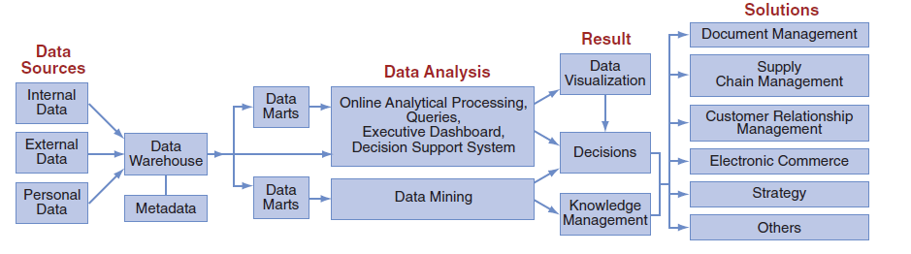
Importance of data, issues involved in managing these data, and their life cycle
IT applications cannot be performed without using data. Data should be accurate, complete, timely, consistent, accessible, relevant, and concise. Managing data in organizations is difficult for various reasons:
(1) the amount of data increases with time;
(2) data are stored in various systems, databases, formats, and languages; and
(3) data security, quality, and integrity are often compromised.
The data life cycle starts with data collection. The data are stored in a database(s) and then preprocessed to fit the format of a data warehouse or data marts. Users then access data from the warehouse or data mart for analysis. The result of all these activities is the generation of decision support and knowledge.

Slide 3
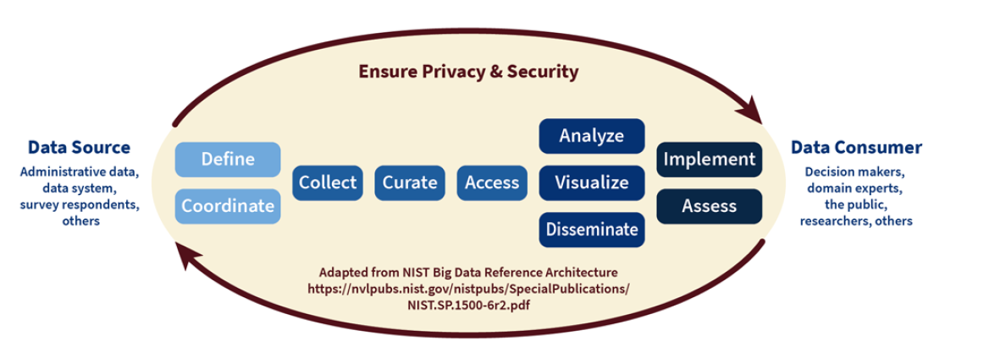
Federal Data Lifecycle
Data roles
• Define: Identify agency and stakeholder needs for data of sufficient quality for intended uses
• Coordinate: Assess the ability of data resources and infrastructure to meet agency and stakeholder needs
• Collect: Organize, plan, and execute data collections and acquisitions to meet agency and stakeholder needs
• Curate: Organize, refine, and maintain agency data resources with sufficient quality to meet agency and stakeholder needs
• Access: Identify and develop multiple data access methods for agency staff and stakeholders
Analyze: Optimize the ability of staff and stakeholders to use agency data to generate insights
• Visualize: Present data insights for consumption by leaders and stakeholders
• Disseminate: Provide multiple avenues for release of data and insights
• Implement & Assess: Maximize the use of data for decision-making, accountability, and the public good and continuously improving the data process

Slide 4
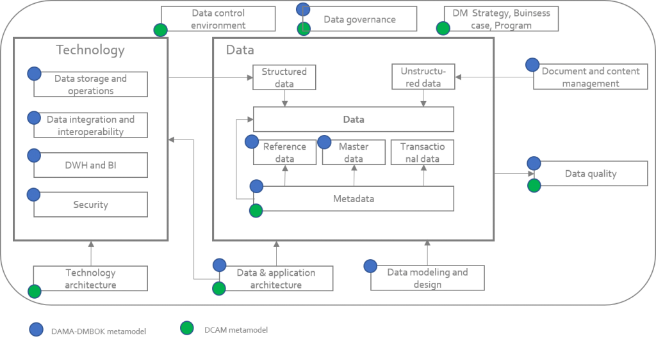
https://datacrossroads.nl/2018/12/02/data-management-metamodels-damadmbok2-dcam/

Slide 5
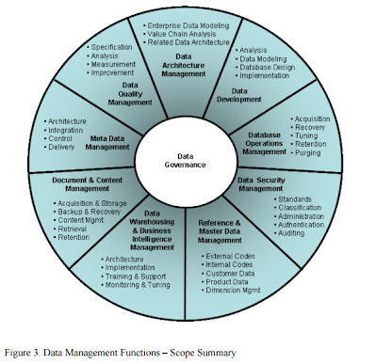

Slide 6
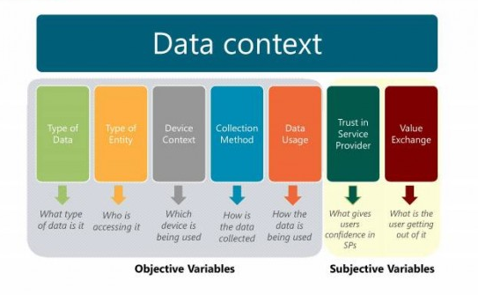
Data Context

Slide 7
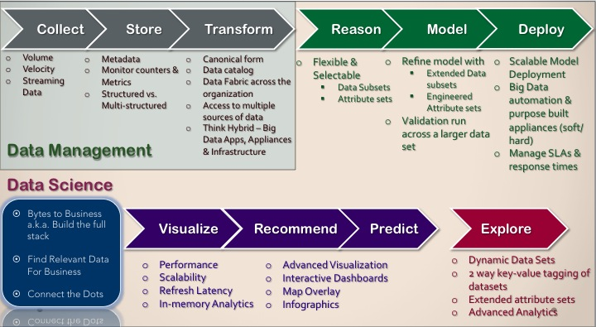
The Data Pipeline
JADC2 Goals:
Visible
Accessible
Understandable
Linked
Trustworty
Interoperable
Secure
(VALTIS)
https://doubleclix.wordpress.com/2013/10/06/big-data-on-the-other-side-of-the-trough-of-disillusionment/
Notes:
Visible Can the consumer discover the source?
Accessible Can he obtain the source content?
Understandable Can he know what the content means?
Linked Can he exploit connections between sources?
Trustworthy Can he believe what the content says?
Interoperable Can his applications correctly process the data?
Secure Is the source protected from unauthorized use and manipulation?

Slide 8
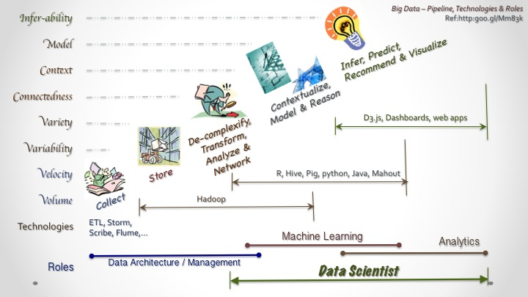
Big Data
https://doubleclix.wordpress.com/category/scalability/

